Slide 1
TankInATank
12/13/2017-Iteration 3
Team 1
Presenting Today:
Linlan Chen, Shuhan Liu,Haotian Wu,
Baoxiang Yang,Lei Yang, Qiwei Zheng,

Slide 2
Overview
Requirement
Design
Implementation
Testing
Project Management
Demo

Slide 3
Motivation
2.5D local multiplayer tank fighting game
We don’t see any recent 2.5D tank game has this vintage play mode that is fun to play with friends sitting side-by-side. It’s a fantastic play mode that you can have fun with family and friends in a party, so we decided to make our own.

Slide 4
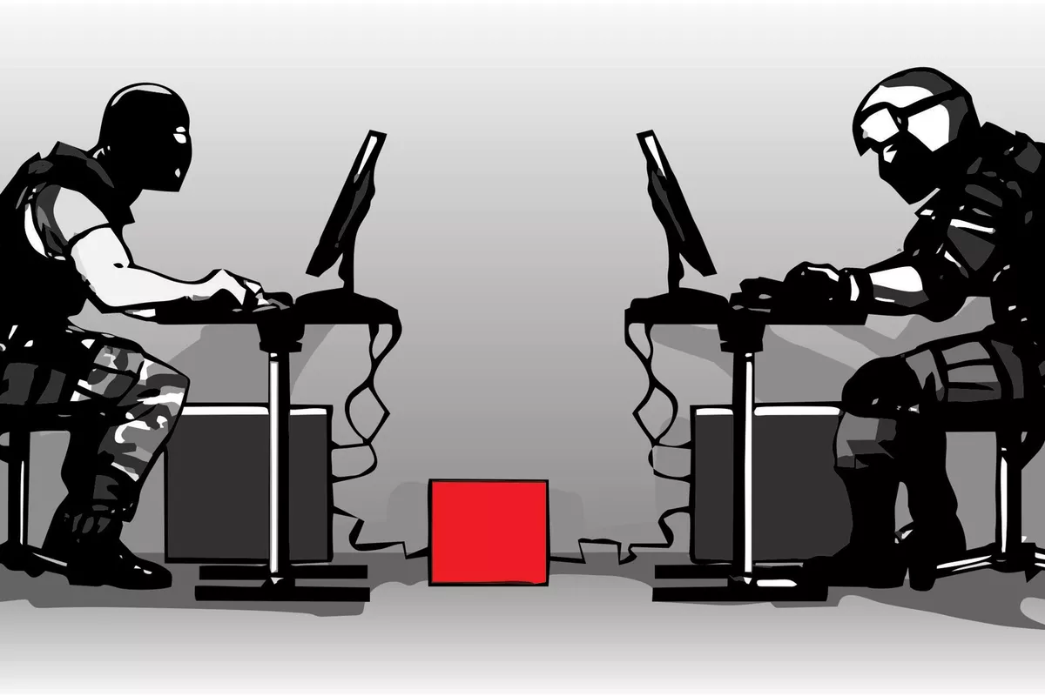
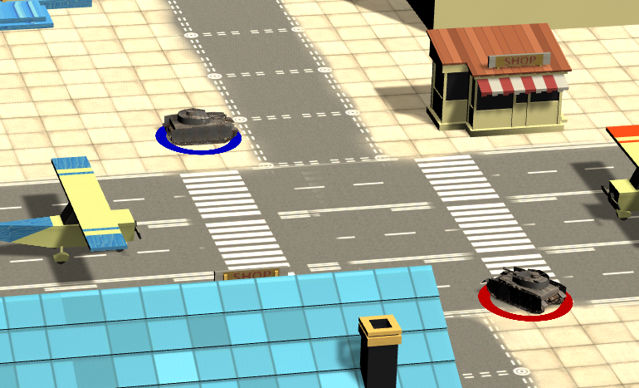
Local Multiplayer Games: Games can be played by multiple users on a singular device
2.5D game is a kind of game that visualizes the scene in 3D but has the characters moving on a 2D plane. The camera will have a fixed angle and looks towards the plane and the characters only have 4 direction of movements.

Slide 5

Requirement - Functional Requirements
Essential Features:
Start game with another player on the same screen.
Pause, restart or quit the game during the game.
Choose a tank.
Choose one map out of three.
Let system randomly choose one map.
Let the tank move left, right, up or down.
Let the tank shoot shell and if a shell hits a tank, tank will lose HP..
Tank has HP and game will be over if one tank loses all HP.
Tank will have areas(mountains, etc) where cannot move through.

Slide 6
Requirement - Functional Requirements
Desirable Features:
Let system randomly choose map.
Choose different types of tank.
Use items to recover HP, increase attack or speed up.
Can destroy small objects on the map by shooting shell.
Have more than 5 maps to choose.

Slide 7
Requirement - Functional Requirements
Optional Features:
Can let system generate a map randomly.
The explosion of object on map will deal damage to tank.
Can play the game alone.
Can play the game with other players online.

Slide 8
Requirement - Nonfunctional Requirements
Understandable menu.
Nice game art design and UI design.
Reasonable speed of tank movement.
Reasonable tank size.
Detailed game instructions.

Slide 9
Requirement - Analysis
 | Planned | Completed
Essential Features | 9 | 9
Desireable Features | 5 | 2
Optional Features | 4 | 1
Nonfunctional Requirements | 5 | 5

Slide 10
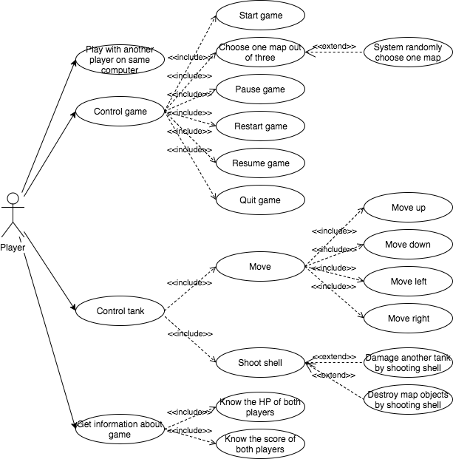
Requirement - Use Case Diagram

Slide 11
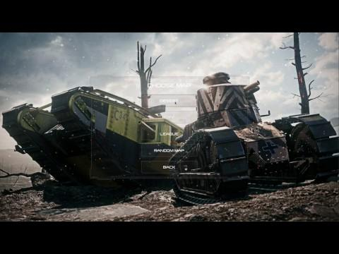
Requirement - Use Case Example
As a user, I can select different map.

Slide 12

Requirement - Use Case Example
As a user, I can let system randomly choose map.

Slide 13
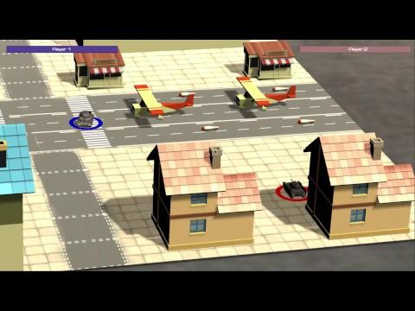
Requirement - Use Case Example
As a user, I can control the tank to move.
As a user, I can control the tank to shoot shell.
As a user, by holding the fire button, I can let the tank shoot farther

Slide 14
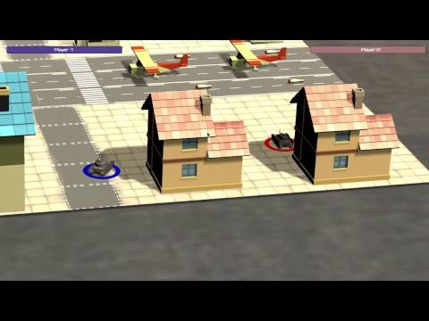
Requirement - Use Case Example
when moving towards the boundary of the map, I won’t let my tank move outside of the designed game area or go through objects on the map, while small objects can be pushed around.

Slide 15
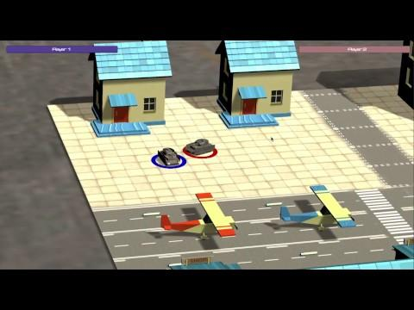
Requirement - Use Case Example
As a user, I know both of the player’s score after each
The game ends after one of the players wins five rounds.

Slide 16
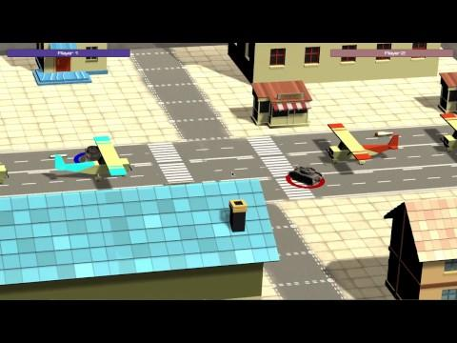
Requirement - Use Case Example
As a user, when shooting at certain objects, they can be destructed.
Some of the big destructible objects deals damage to the tanks and other object when they explodes.

Slide 17
Design
Architecture
Design Pattern
Class Diagram

Slide 18
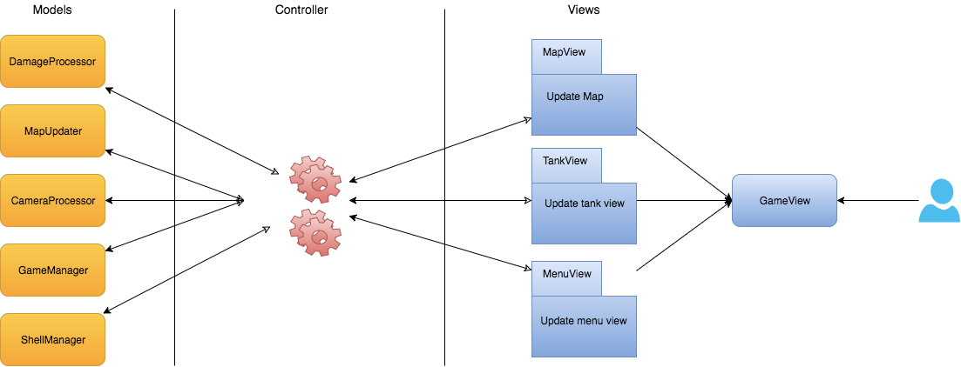
Architecture - MVC

Slide 19
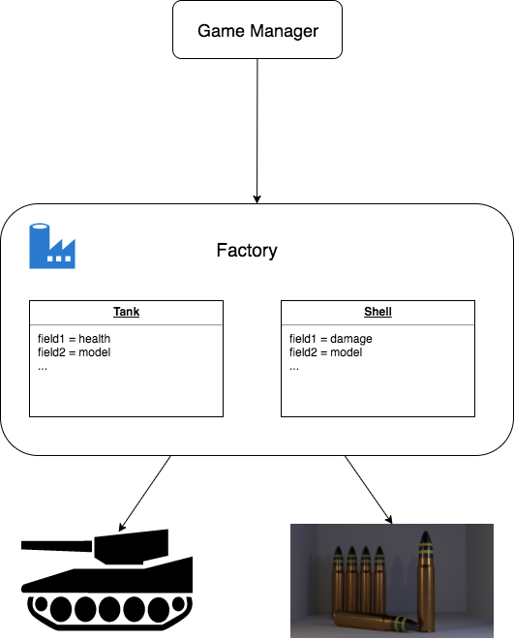
Factory Design pattern
Create object efficiently
Reuse most memory
Fit unity framework

Slide 20
Other design pattern
Object Pool Avoid expensive acquisition and release of resources by recycling objects that are no longer in use For the decorational objects, like trees, plan, rocks in the map. They are saved in object pool.

Slide 21
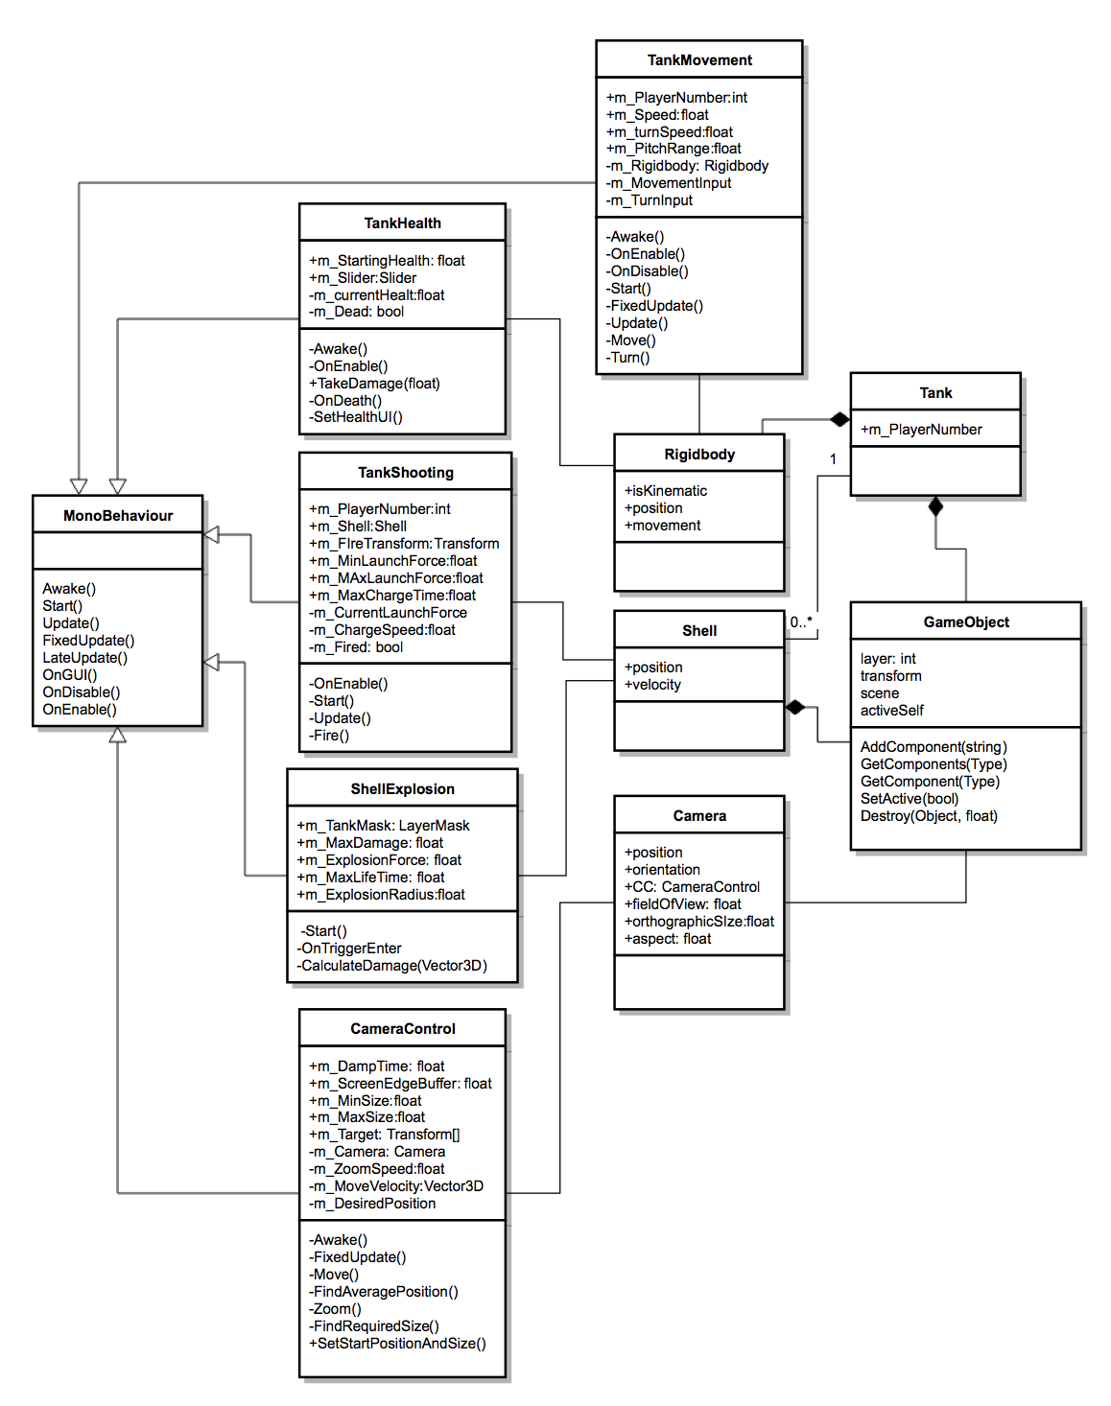
Class diagram

Slide 22
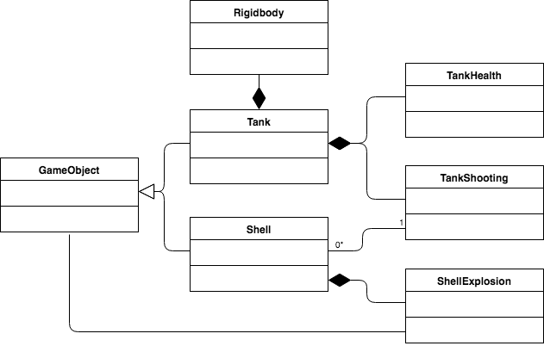

Slide 23
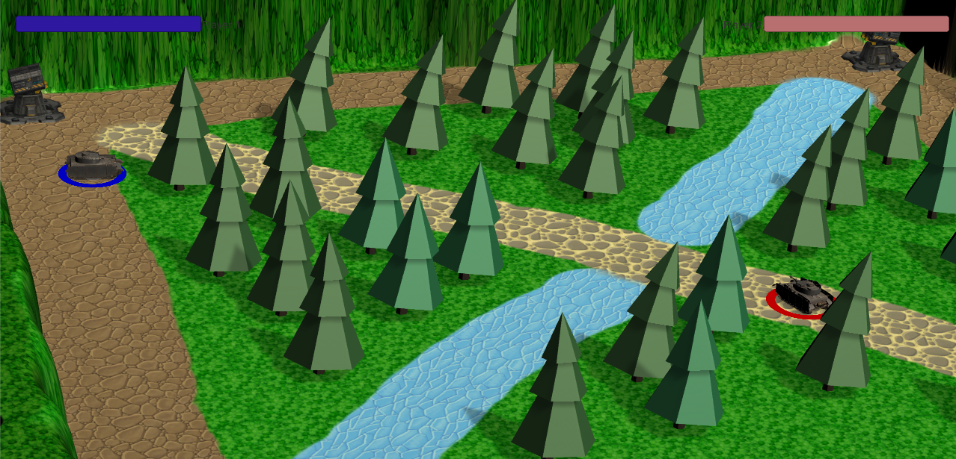
Camera
Max Distance Between Characters
Center of View:
Average Position of all the characters.
Field of View Angle: Calculated based on the max distance between characters, distance from the camera to the plane and an edge buffer. (Has a minimal angle constraint)
Center of View
Edge Buffer

Slide 24
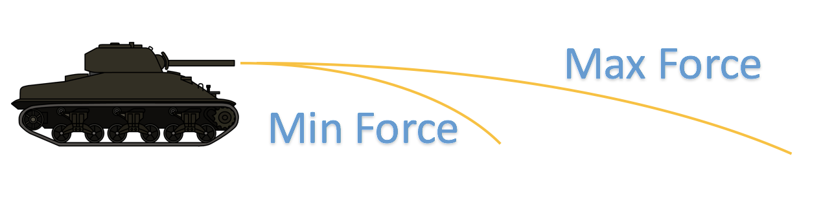
Algorithm - Shooting
The shooting range depends on how long the user press the fire button. In our design, to reach the max firing force, the user has to press the key for 0.75s.
In order to make this game real, the shell is designed to be affected by gravity. It will fall on to the ground finally, instead of shooting in a straight line

Slide 25
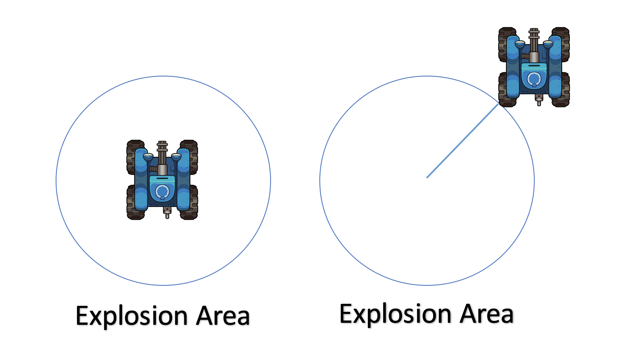
Algorithm - Shell explosion
Once the shell hits an object, it will explode. However, it will not only deal damage on that collider, instead, it will create a explosion area. Therefore, even the tank is not hit by a shell, if it is in the explosion area, it will receive damage.

Slide 26

Implementation - Project Structure
Game Manager
Records info about round, wins, camera, choosing map, canvas etc.
Map
Tank Manager 1
Tank Manager 2
Has Info about the shape, size and all the other objects on the map
Keeps Track of tank health
Enable Control
Reset

Slide 27
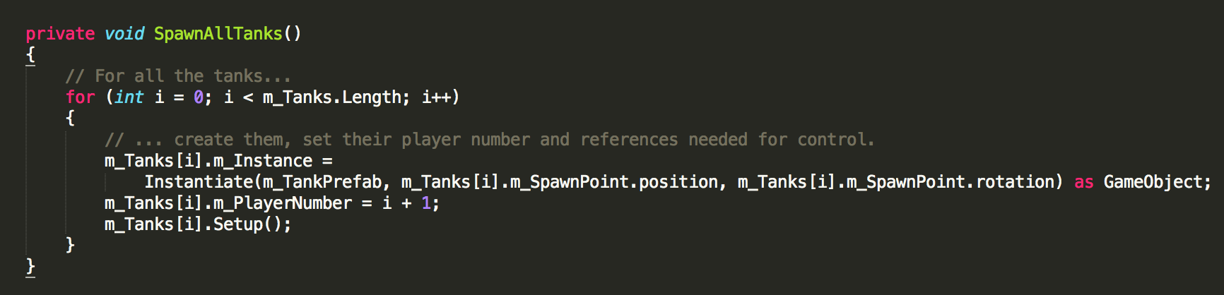
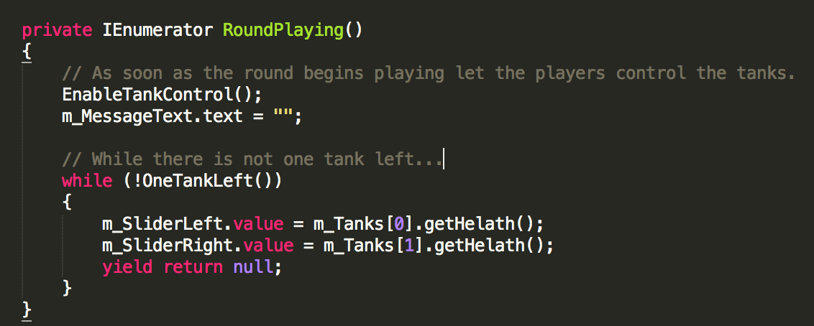
Implementation - Code example
GameManage.cs
Initialize tanks
Enabling control and updating health bar

Slide 28
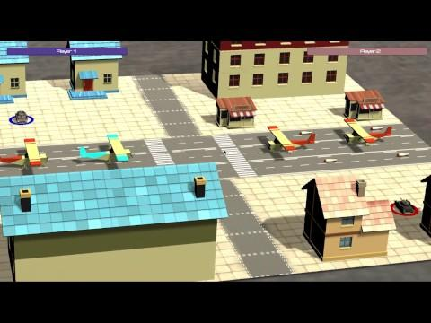
Demo

Slide 29
Testing
We conduct three kinds of testing:
- Unit test
- System test
- Acceptance test

Slide 30
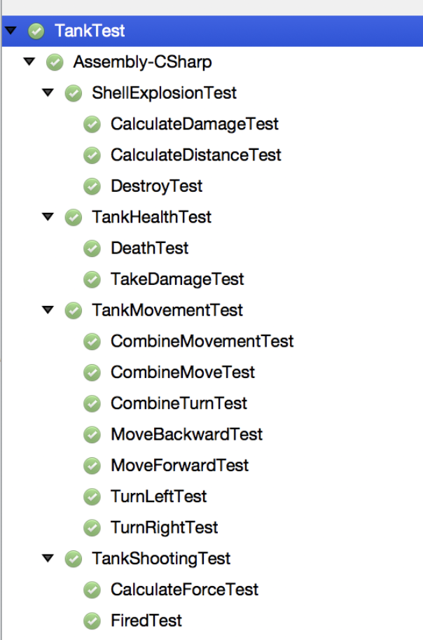
Testing - Unit test
We have 14 unit tests to test tank movement, shell explosion, tank health and tank shooting function.
Pass 14/14.
Test coverage:
Statement Coverage | 93.8%
Branch Coverage | 100%

Slide 31
Testing - System test
We conducted system tests on the complete, integrated game to evaluate the compliance with its specified functional and non-functional requirements.
Each player can pause, restart or quit the game during the game.
The two players can choose one map out of three.
Both of the players can make the tank move left, right, up or down.
...
To make sure map size is reasonable, the tank should be able to move across the tank within 20 seconds.
Detailed game instructions.

Slide 32
Testing - Test case example
Tank will have areas(mountains, etc) where cannot move through.
Test item | Precondition | Test Steps | Postcondition
Restricted areas | The map has outlined its border. | 1. Control tank A. 2. Try to make it move across the border of the map. | The tank stops.
Restricted areas | There are some restricted terrains on the map. | 1. Control tank A. 2. Try to make the tank move across some barriers, take trees in league map for example. | The tank stops.

Slide 33
Testing - Test case example
Shell can explode.
Test item | Preconditions | Test Steps | Postconditions
shell | Tank can fire successfully and shell's max lifetime has been set. | 1. Control a tank. 2. Fire in a no-object direction. 3. Wait until the max lifetime of shell passed. | The shell explodes.
shell | Tank can fire successfully. | 1. Control a tank. 2. Fire towards another tank. Make sure two tanks are very close, the shell of tank A can reach tank B within its max lifetime. | The shell explodes.

Slide 34
Testing - Acceptance test
We have 49 acceptance tests and the game has passed all of them.
Examples:
Given a tank is death, when the other tank still want to deal damage to it, there will be no more hp loss.
Given a tank is inside a shell's explosion radius, when the shell explodes, the closer it's to the shell, the more damage it will suffer.
Given the tank has go through continuous collisions, when it meets collider again, it will not move through the collider.

Slide 35
Testing - Other metrics
We have 35 test cases and 12 bugs in total. 9 bugs are raised by 7 test cases and the other 3 are found during development process.
Test pass rate:
80% -> 100%
Defect Density:
20%
Fixed rate:
100%

Slide 36
Project management - Index
role assignment as well as each individual contribution, risk management, quality management, particularly the quality metrics collected throughout the project, process improvement, iteration evolution, achievements of the project, challenges in the project, lesson learned.

Slide 37
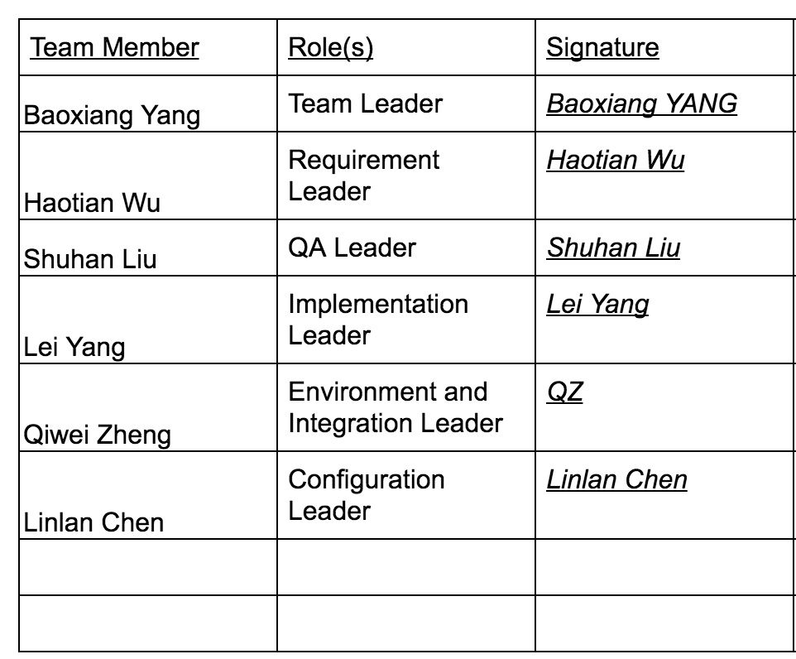
Project management - role assignment

Slide 38
Project management - Contribution
Team Member | Roles | Main Contribution
Baoxiang Yang | Team Leader | Three Maps design and Implementation. Weekly Meetings’ schedule. Team group tasks assignment.
Haotian Wu | Requirement Leader | Game Manager. All menu. Tank movement.
Shuhan Liu | QA Leader | Tank shooting Shell explosion Tank health damage
Lei Yang | Implementation Leader | Tank fighting system Tank health UI and damage calculation Github environment resolver
Qiwei Zheng | Environment and Integration Leader | Tank movement Camera control Object explosion
Linlan Chen | Configuration Leader | Meeting minutes taken Testing part: Unit test, System test, Acceptance test

Slide 39
Project management - risk management
Risk Description | Risk Impact Loss | Risk Handling Strategy
No previous game development experience. Low learning rate | 10 hours ~ 30 hours | Divided into three groups, each focus on one part and do the group learn each week.
Bugs under automatic generated files. | 20 hours ~ 35 hours | Try to change the method. If still fails, try to edit this feature
Key functions hard to achieve because of the previous implementation | 15hours ~ 20 hours | Assign an additional member to solve the previous bug. Groups work of 3 people on the key functions
No automatic testing tools on Unity. | 10 hours ~ 20 hours | Assign an additional member to manually add tests on the code.
UI is not consistent | 5 hours | Assign an additional member to make sure the UI design and then implement in a group of 2 people.

Slide 40
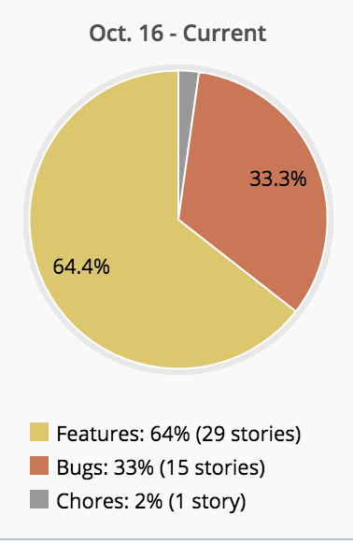
Project management - quality management
Features | Code Lines | Test Coverage | Bugs report | Man hours
Essential Features | ~3000 | 100% | 12 | 140
Desireable Features | ~1500 | 83% | 5 | 60
Optional Features | ~1000 | 50% | 2 | 30
Additional Features | ~500 | 50% | 1 | 30

Slide 41
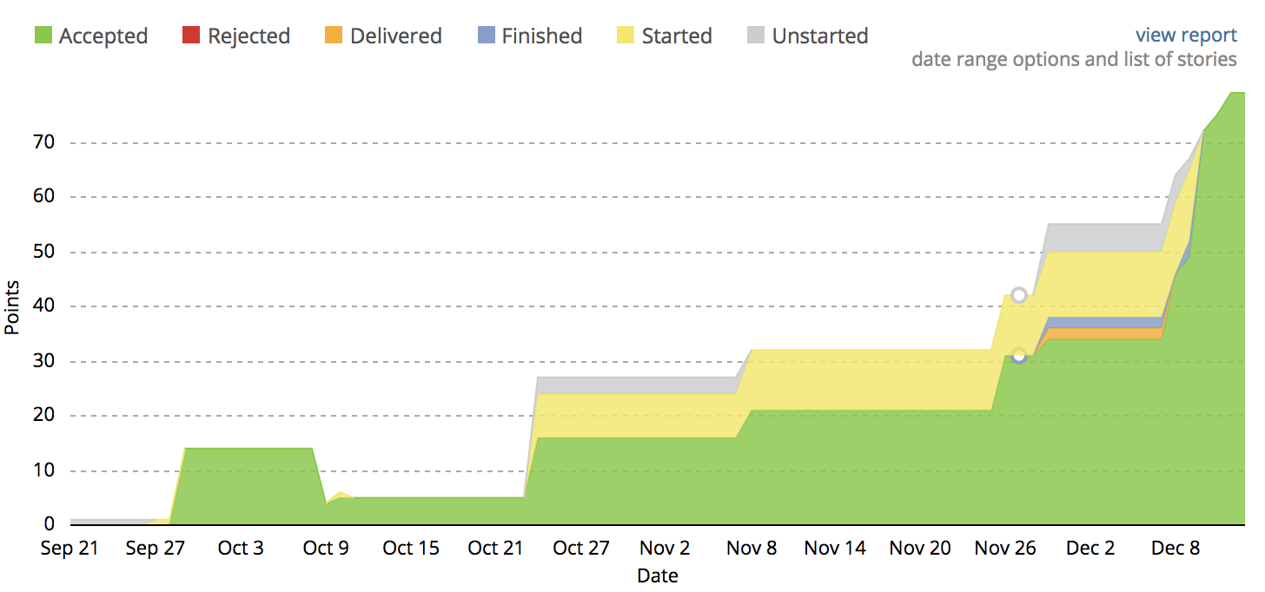
Project management - process improvement

Slide 42
Project management - iteration evolution
Iteration 1:
Environment setting.
Desert Map design and implementation.
Basic Tank model and movement logic.
Iteration 2:
Tank shooting function and explosion.
Forest Map design and implementation.
Tank health, died mechanism.
Iteration 3:
Main menu design and implementation.
Airport Map design and implementation.
Game pause, start, end.
Select different maps.

Slide 43
Project management - work load
Requirement analysis: 20 hours
Design: 20 hours
Essential Features coding: 84 points * 2 = 168 hours
Key features’ bugs fixing: 20 * 2.5 = 50 hours
Total mans’ hour on coding: 258 hours
Weekly meeting : 2 * 12 = 24 hours
Group learn: 2 * 12 = 24 hours
Documentations: 2 * 12 = 24 hours
Total hours for each on average: (258 /6 + 26 + 26 + 26) / 13 = 9.85 / week

Slide 44
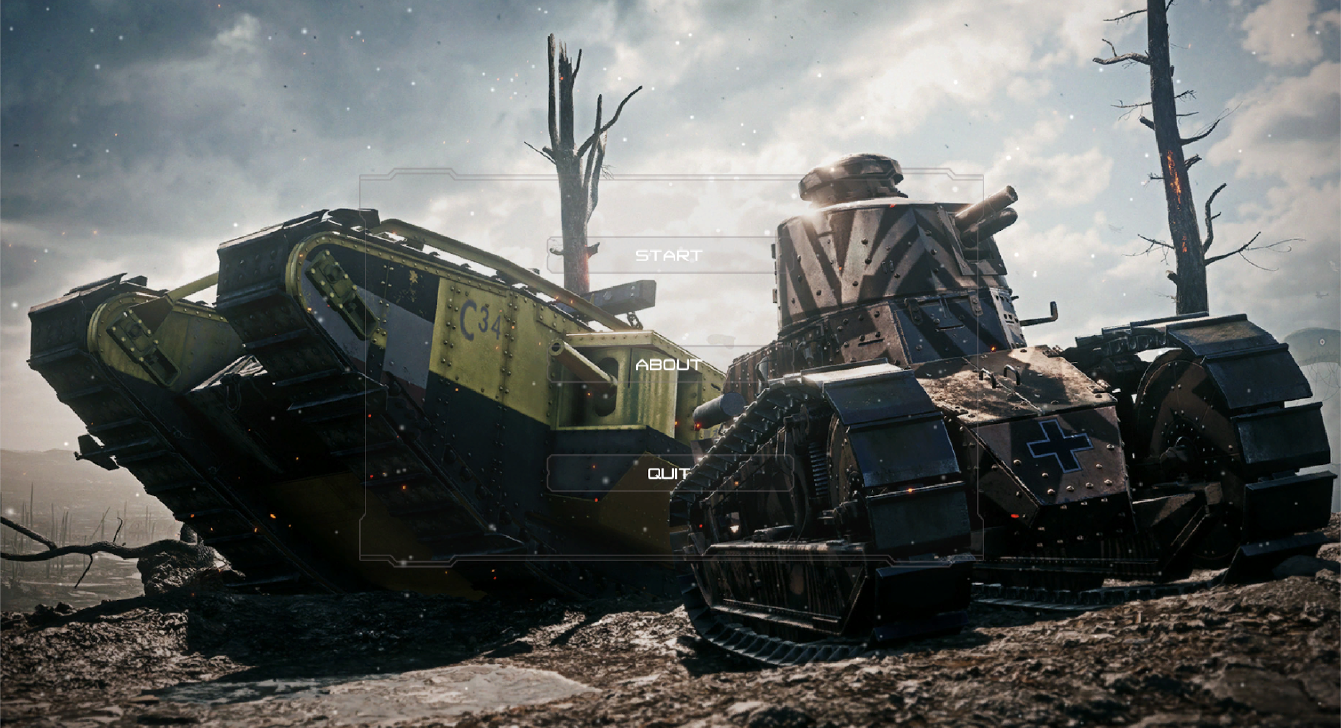
Achievement!
Well, we made our own game!
6 people work quite smoothly, everyone got assigned works to do in each week. Nice job Team!

Slide 45
Challenges and lessons
Challenges:
No previous game development experience
Lessons:
Do it before you think
Think it clearly before you coding.

Slide 46
Q&A
12/13/2017-Iteration 3
Team 1
Present Today:
Qiwei Zheng, Linlan Chen, Lei Yang
Baoxiang Yang,Lei Yang, Qiwei Zheng,

